Slide 1

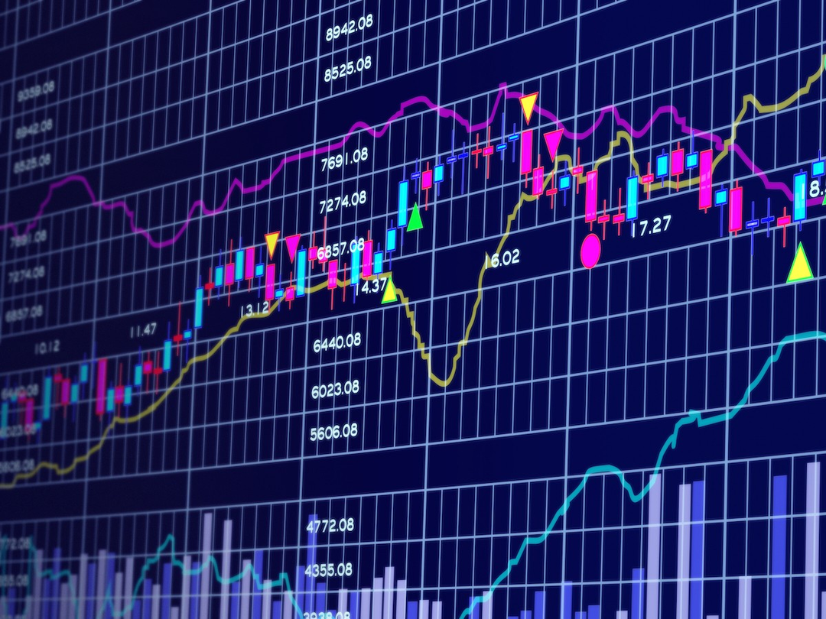


Unveiling Similarities: Text Analytics in Financial Reports
Group 2 - Anu Lakhani, Sanya Jolly, Sandy Agustines, Somya Jindal

Slide 2
Executive Summary / Abstract
This study analyzes the textual content of Tesla and GM's annual financial reports (10-K reports) from 2011 to 2024, with the aim to identify similarities and differences in how they describe their business strategies.
Annual Reports (10K) and (10Q) reports filled with the Securities and Exchange Commission provides critical insights into the performance and operations of companies.
The two automotive giants' textual similarities can be seen using Cosine and Jaccard similarity metrics.
Our analysis tracks how Tesla and GM present their strategies over time, highlighting areas where their focus overlaps and where they take different paths.

Slide 3
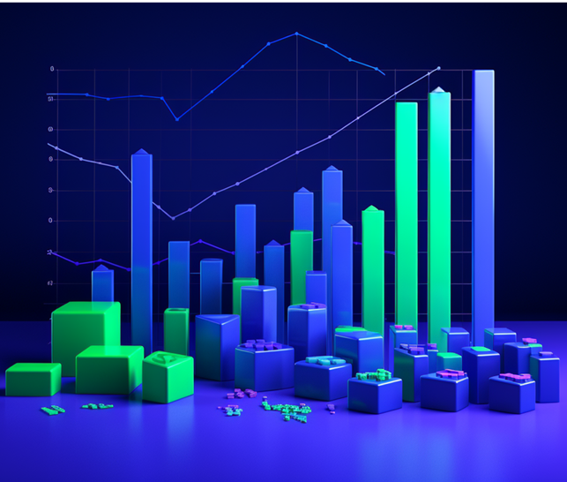
Business Goal Analysis
What is being done now to address the goal?:
Traditional financial analysis focuses heavily on numerical data within 10-K reports.
Some qualitative analysis of the text may be conducted, but it's often manual and less systematic.
Why is text analytics needed?
The language used in 10-K reports offers rich insights into company strategy, priorities, and how they perceive the market.
Text analytics automates the analysis of large textual datasets at scale, revealing patterns that manual reading can miss.
What can it potentially achieve?
Track competitor strategies: Pinpoint where Tesla and GM's messaging converge or diverge, aiding competitive benchmarking.
Identify market trends: Uncover shared concerns, emerging themes, and changing sentiment within the automotive sector.
Refine strategic positioning: Adapt messaging and strategy in light of competitor actions and broader industry trends.

Slide 4

Data Description
Analyzing Tesla and General Motors’ 2011-2024 10K reports from SEC's EDGAR:
Data Source: 10-K reports from SEC's EDGAR.
Data Format: HTML and XBRL (XML), prepared for text analysis.
Data Size: Approx 751 kb for all files, representing the financial years 2011-2024.
Data Scope: Focus on Tesla and General Motors for the years 2011-2024.
Preprocessing Steps: Rigorous techniques for clean, structured analysis-ready data.
Feature Extraction: Employing TF-IDF and word embeddings for financial narrative quantification.
Challenges: Managing large files, complex formats, and ensuring post-conversion data accuracy.
Analysis Goal: Report consistency and similarity evaluation through content and structure analysis.

Slide 5

Tools
Data Handling: pandas
NLP and Text Processing: NLTK
Text Analytics: Scikit-learn, VADER, NLTK
Machine Learning: Scikit-learn
Visualization: Matplotlib

Slide 6
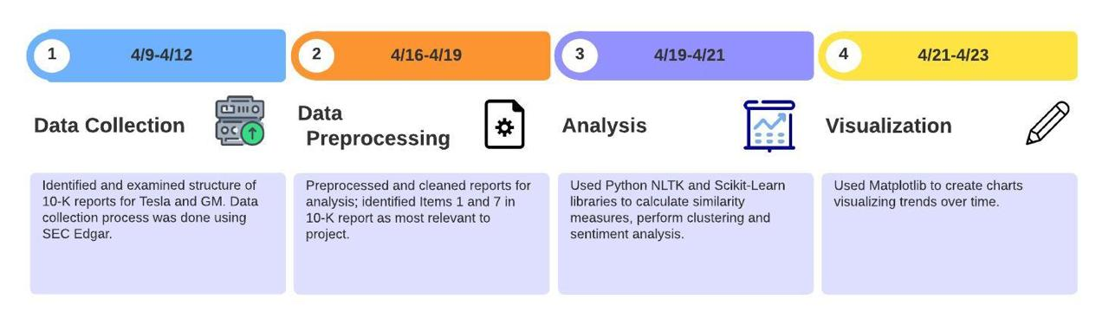
System Design

Slide 7
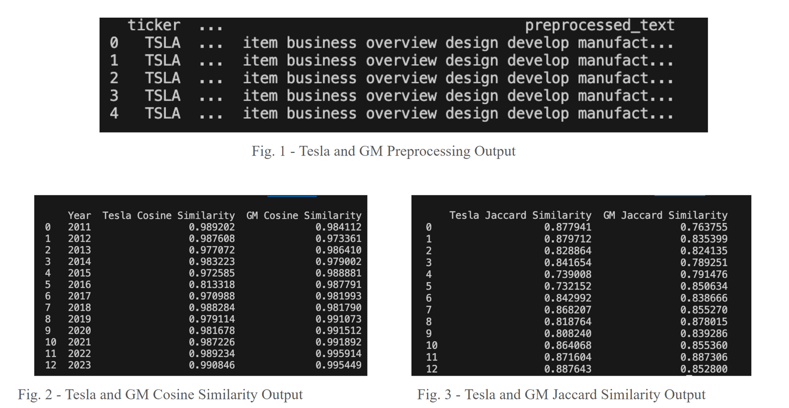
System Implementation

Slide 8
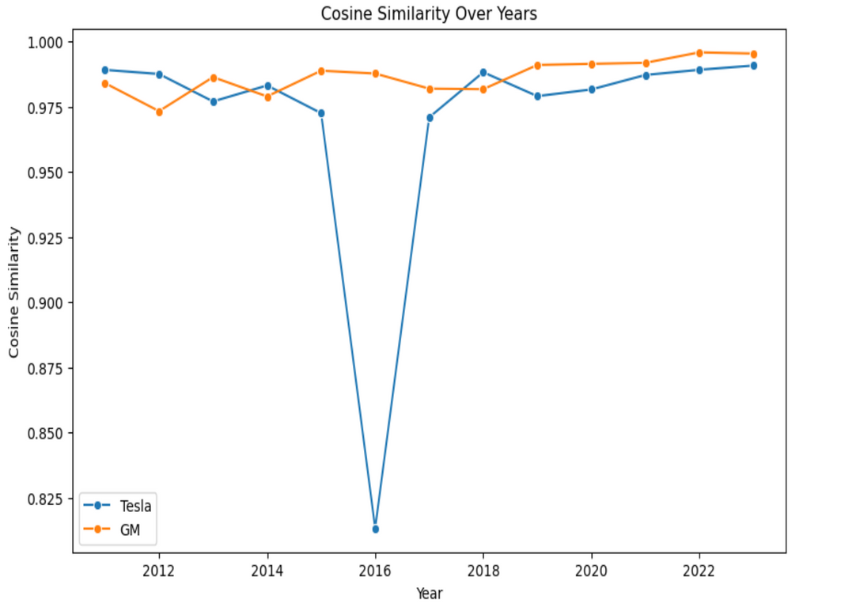
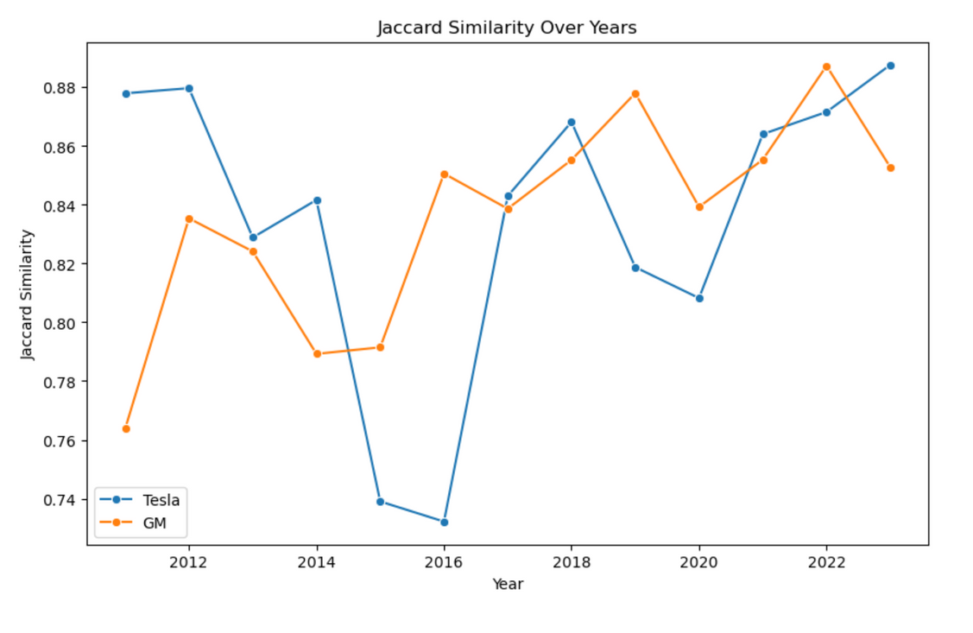
Analyses and Visualizations
Fig 1: Cosine Similarity analysis Line Charts for Tesla and GM
Fig 2: Jaccard Similarity analysis Line Charts for Tesla and GM
A. The Cosine similarity trends for both companies show volatility, with Tesla having more pronounced fluctuations.
B. The variation in similarity scores suggests periods of change or divergence in characteristics or policies between the two companies.
C. The dip in 2016 can be attributed to Tesla undergoing mass production issues for their Model X SUVs.
A. The Jaccard similarity trends for both companies show volatility, with Tesla having more pronounced fluctuations.
B. The variation in similarity scores suggests periods of change or divergence in characteristics or policies between the two companies.

Slide 9
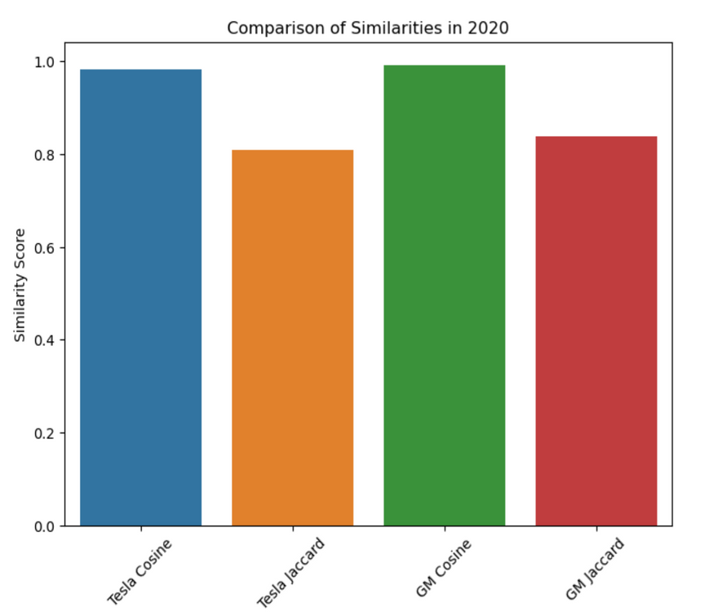
Fig 3: Cosine and Jaccard Similarity analysis bar charts for Tesla and GM
A. The chart compares the Cosine and Jaccard similarity scores for Tesla and GM in the year 2020.
B. Tesla's cosine similarity score is higher than its Jaccard score, while GM shows closer cosine and Jaccard scores.

Slide 10
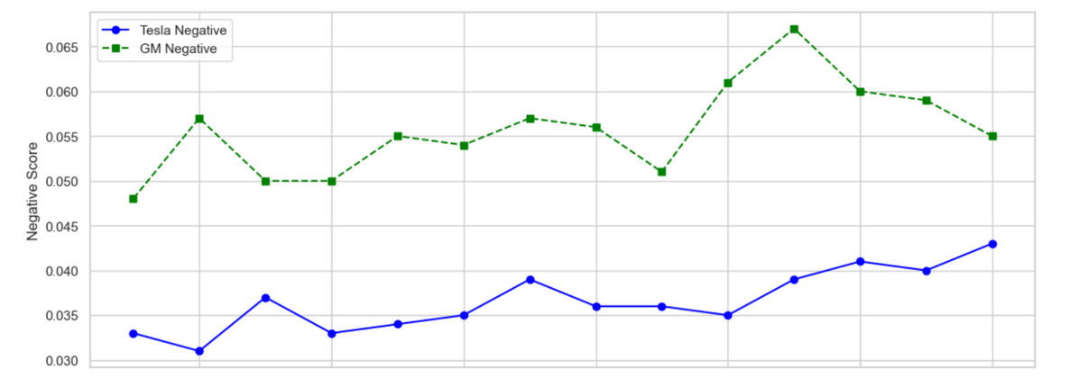
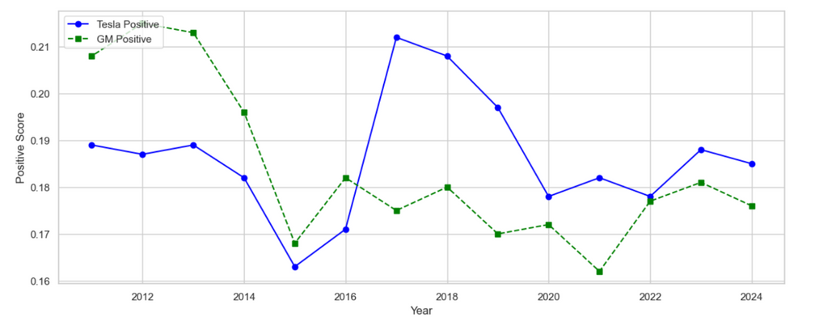
Fig 5: Vader Sentiment Negative Scores for Tesla and GM
Fig 6: Vader Sentiment Positive Scores for Tesla and GM
The chart shows negative sentiment scores for the Management Discussion and Analysis (MD&A) section of Tesla and GM's 10-K filings.
Tesla exhibits lower negative sentiment scores compared to GM, indicating a more positive tone in their MD&A.
This chart displays the positive scores for Tesla and GM for their MD&A section from 10-K filings.
Tesla shows a peak in positive sentiment around 2018, while GM's scores reveal a more consistent pattern, with a slight upward trend in recent years.

Slide 11
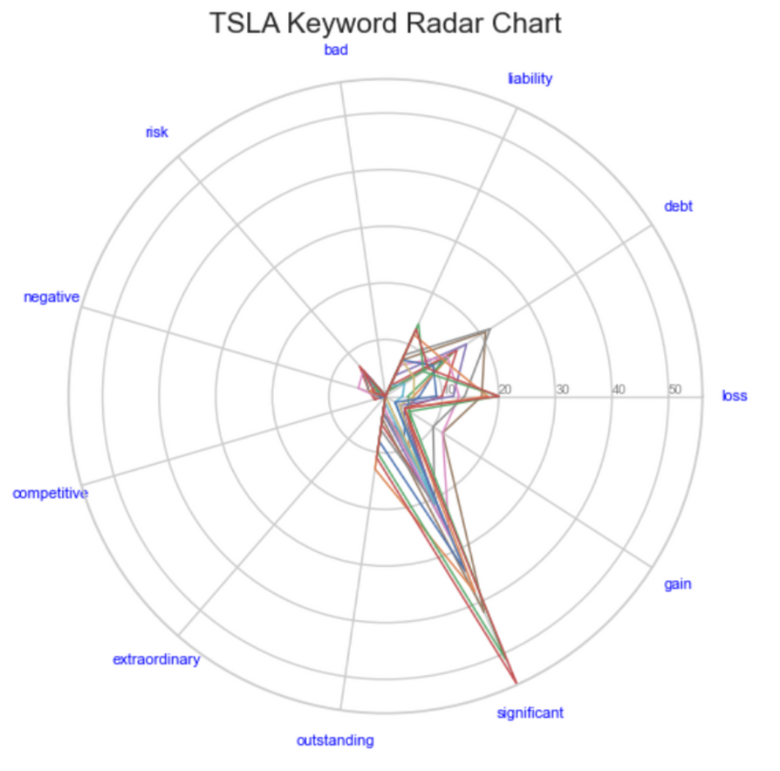
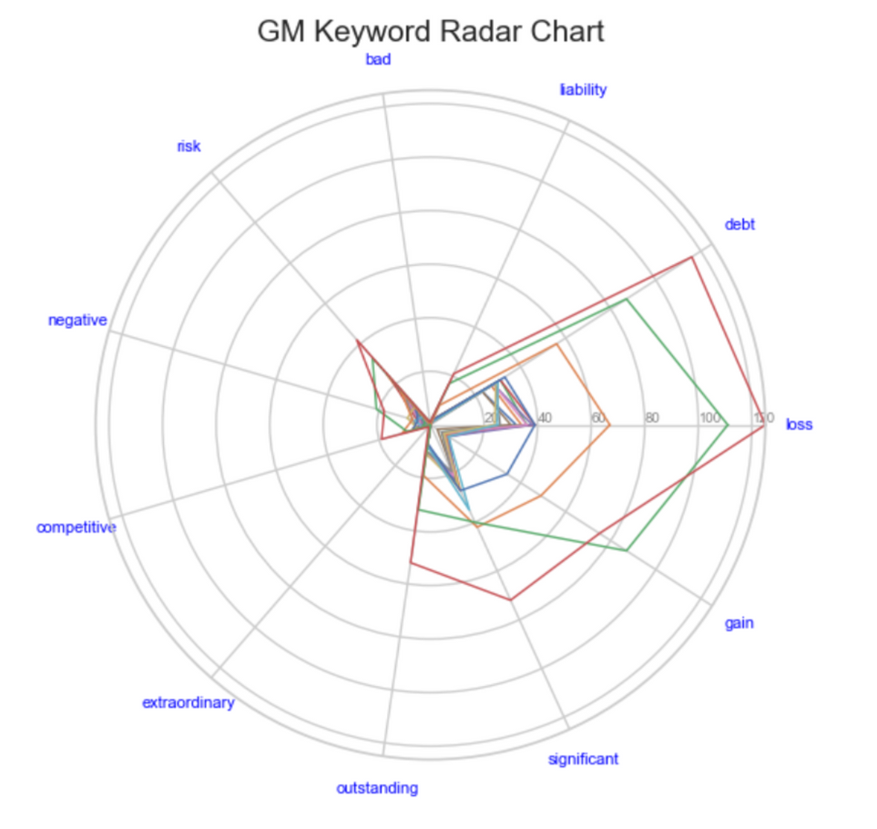
Fig 7: Tesla Keyword Radar Chart
Fig 8: GM Keyword Radar Chart
Radar charts represents the frequency of certain keywords in Management Discussion and Analysis section across multiple filings over time.
Spokes for ‘significant’, ‘gain’, ‘risk’, ‘loss’, ‘debt’, which show greater lengths shows that these terms appear more frequently in Tesla’s discussions.
For GM, the ‘loss’ keyword extends much further out than most other terms, suggesting a more frequent discussion of losses in GM's communications.

Slide 12
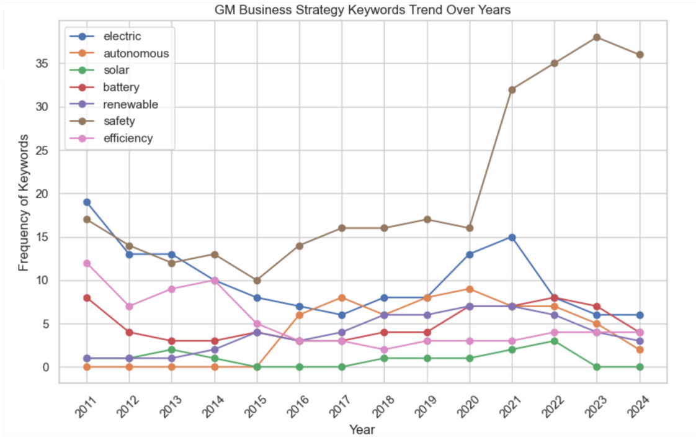
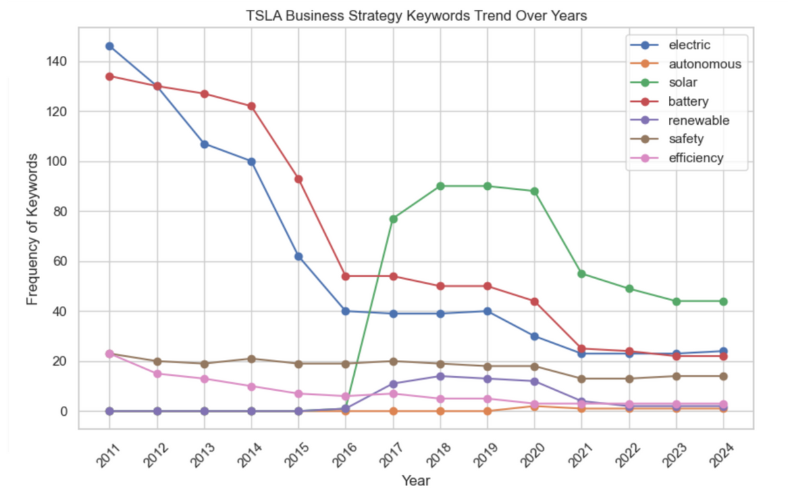
Fig 9: Line Chart for GM Business Strategy Keywords
Fig 10: Line Chart for Tesla Business Strategy Keywords
Frequency of ‘safety’ keyword was stable until 2020, after which there is a significant peak in 2024.
The ‘solar’ keyword maintains a low profile throughout the timeline.
‘Renewable’ does not have a significant presence.
The ‘autonomous’ keyword, peaks around 2017 and 2018.
Frequency of ‘electric’ keyword was high in early years.
‘Solar’ has a substantial peak from 2018 to 2020
‘Safety’ maintains a steady but not a significantly increasing trend

Slide 13
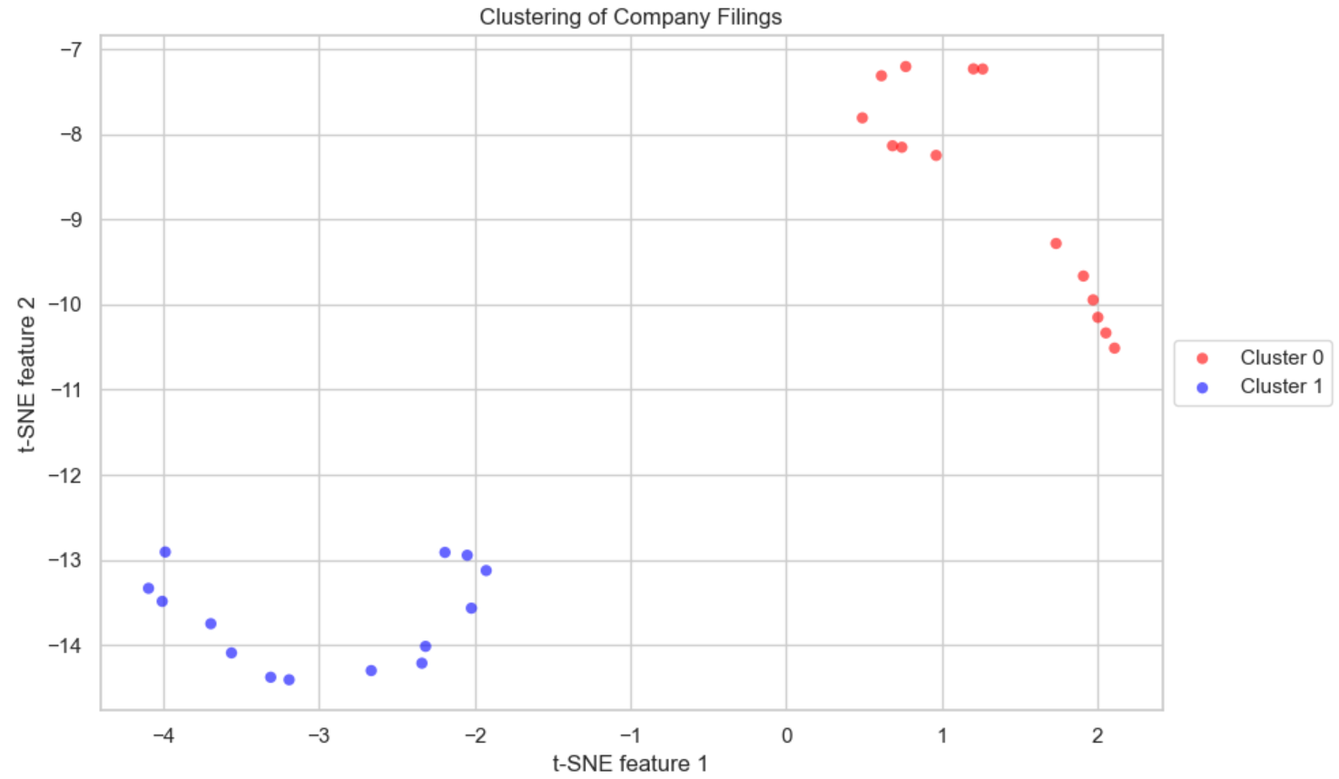
Fig 10: K Means Clustering
Filings of Tesla and GM form distinct clusters.
It shows that their business strategies have unique textual content.

Slide 14
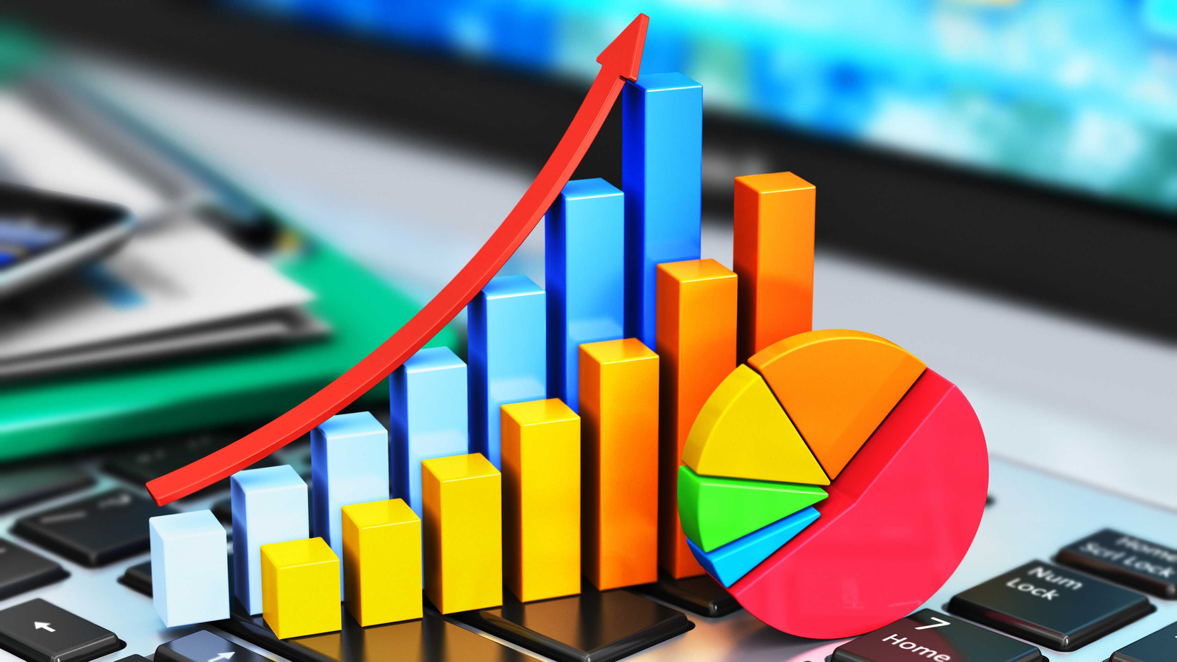
Conclusion
Main Conclusions:
Tesla and GM have mostly similar Cosine similarity measures, indicating similarities in reporting style and focus areas.
There is more volatility in Jaccard measures, which implies that although similar topics are discussed, there is more emphasis on certain topics than others.
Stock prices are likely to fluctuate together given marginal differences in both similarity measures and key terms in their overall business strategies.
Recommendations for Future Direction:
Conduct a longitudinal study
Expand breadth of study across industries
Incorporate impact of regulatory and compliance changes

Slide 15
References
DeBord, Matthew. “Tesla Shares Are Getting Crushed.” Business Insider, Business Insider, 26 Jan. 2016, www.businessinsider.com/tesla-shares-have-been-crushed-this-year-2016-1.
Extract Textual Data from Edgar 10-K Filings Using Python, sec-api.io/resources/extract-textual-data-from-edgar-10-k-filings-using-python. Accessed 22 Apr. 2024.
“Interpretation of Cosine Similarity and Jaccard Similarity (Similarity of Histograms).” Stack Overflow, 21 June 2023, stackoverflow.com/questions/76557362/interpretation-of-cosine-similarity-and-jaccard-similarity-similarity-of-histog.
Muthukumar, Poornima. “Evaluating Methods for Calculating Document Similarity.” KDnuggets, 21 Dec. 2023, www.kdnuggets.com/evaluating-methods-for-calculating-document-similarity.
“SEC Filings.” Tesla Investor Relations, ir.tesla.com/sec-filings#groups=annualquarterlyreports&list_id=tcl-list-1&page=0. Accessed 22 Apr. 2024.
“SEC Filings.” General Motors Company, investor.gm.com/sec-filings?field_nir_sec_form_group_target_id%5B0%5D=471&field_nir_sec_date_filed_value=&items_per_page_toggle=0&&page=0. Accessed 22 Apr. 2024.

